Slide 1
JumpCut: Non-Successive Mask Transfer and Interpolation for Video Cutout
对于跳跃视频的剪辑：非连续性的模型转换和视频抠图
读书报告
裴灵晖
Notes:
Thanks for introduction.
Good morning, everyone, thanks for coming to my talk. Today I will introduce our project, which focuses on an interactive real time video cutout method.

Slide 2
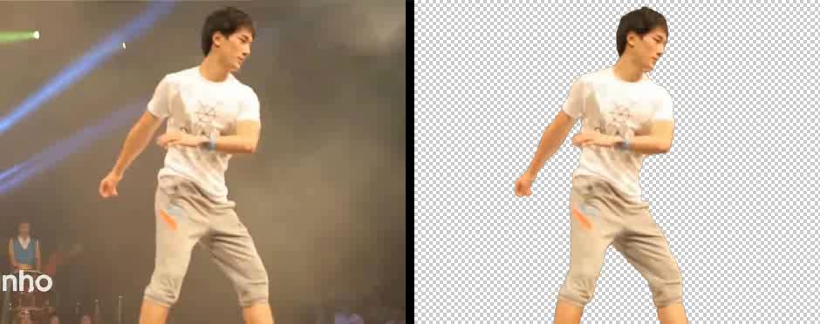
Video Cutout（视频抠图）
Notes:
Video Cutout, which is also known as video foreground extraction, is used a lot in TV and movie production for compositing a visual element from one source onto a new video background.
In this work we are interested in user-assisted accurate separation of complex dynamic objects from their background in natural videos, and specifically videos with large and non-rigid foreground motions, like the ones you can see in this video clip.

Slide 3
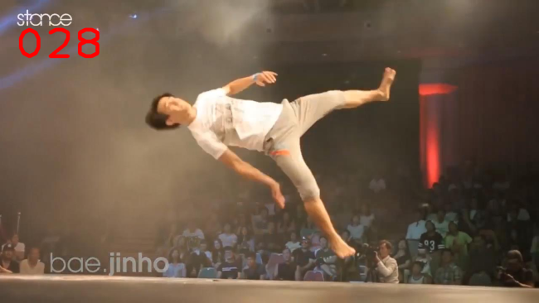
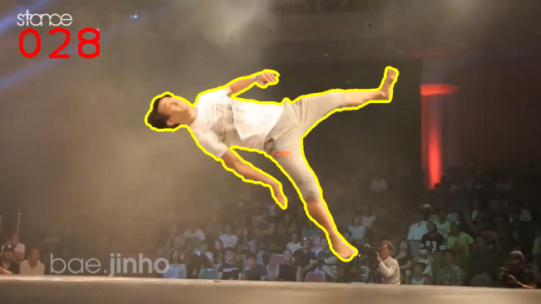

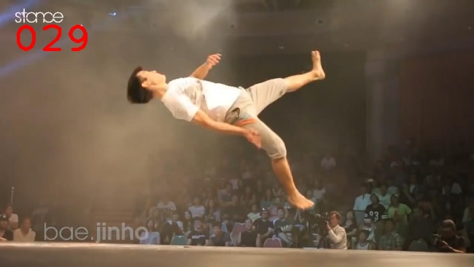
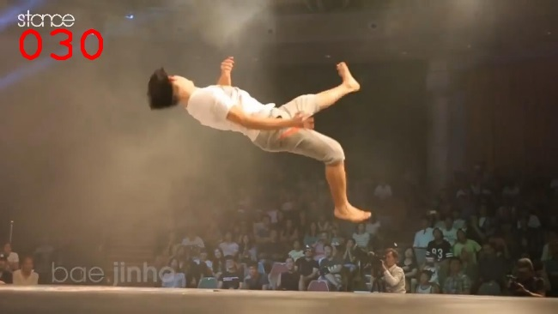
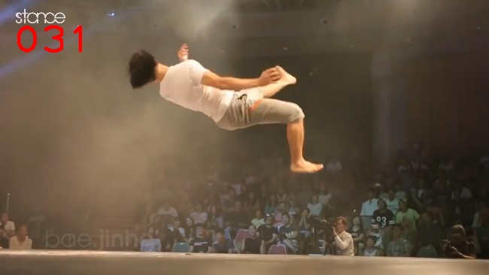
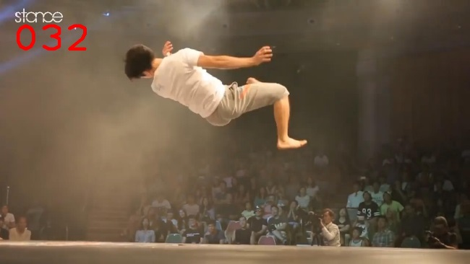
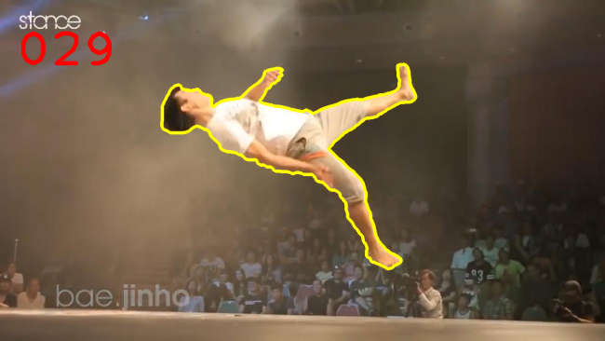
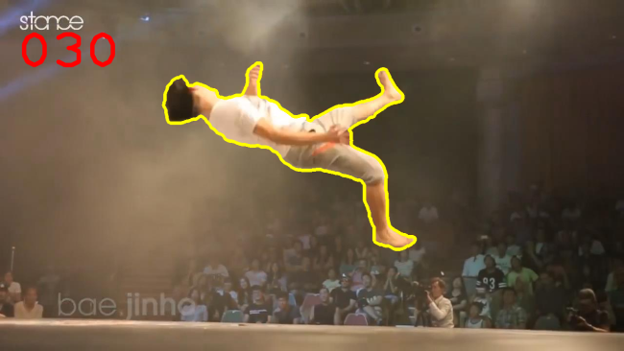
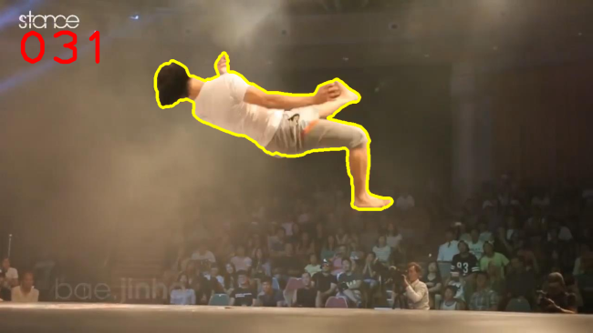
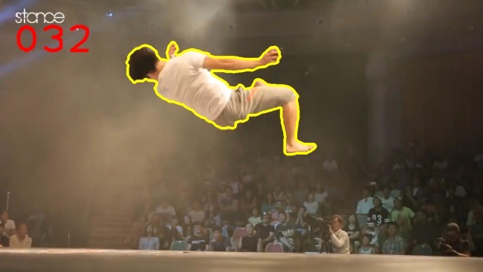
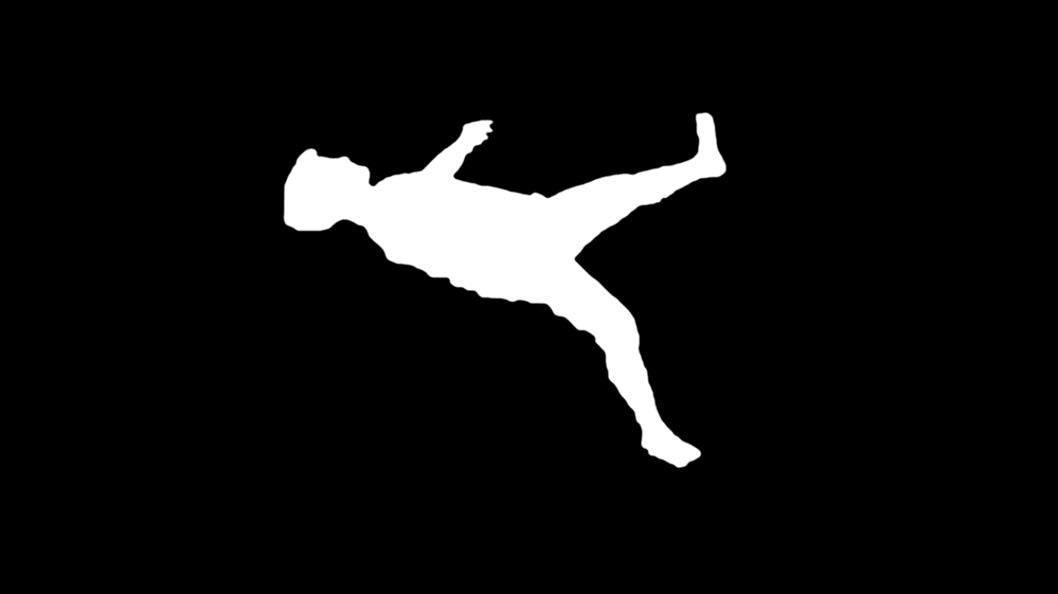
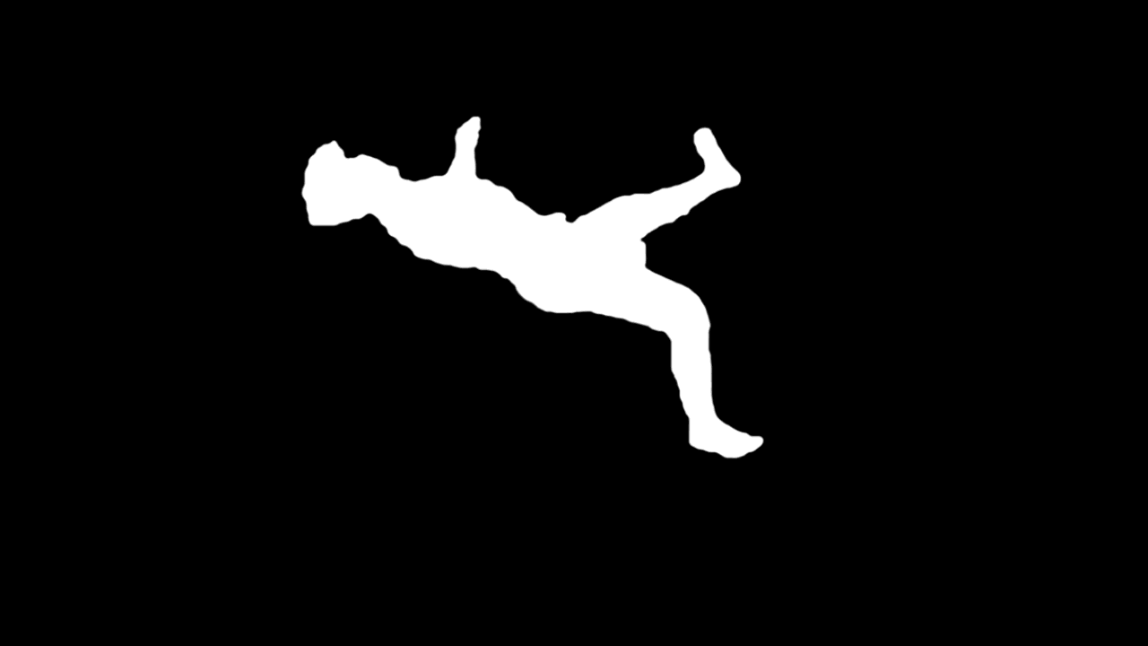
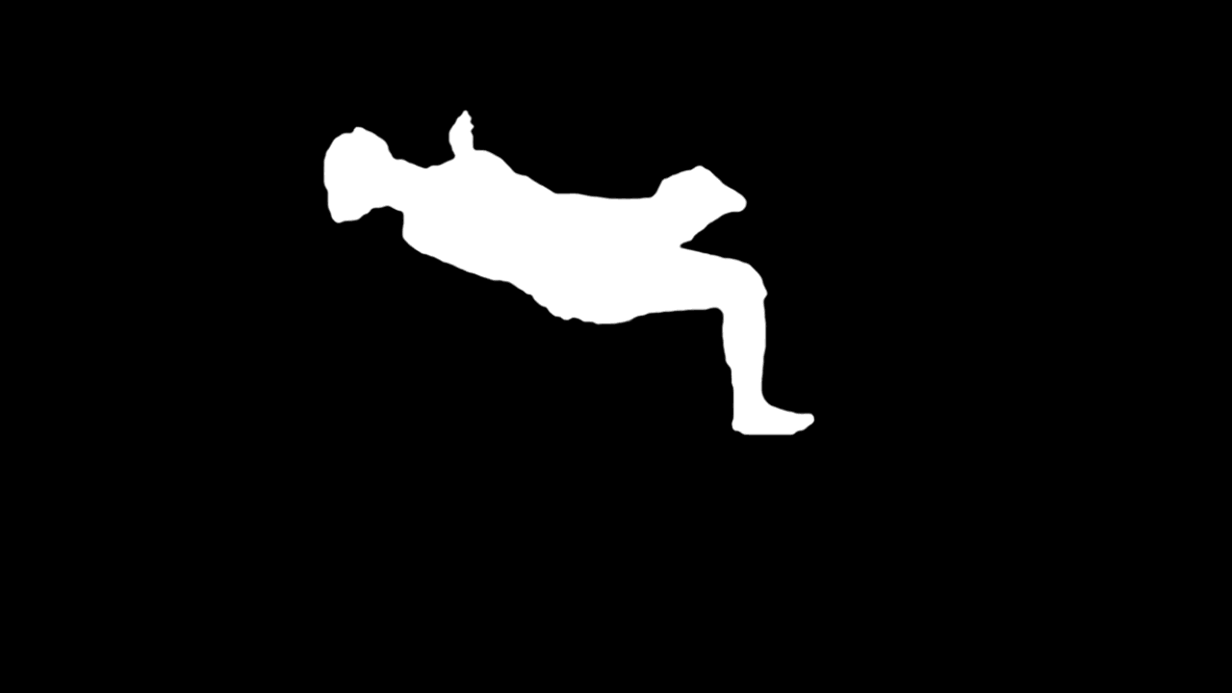
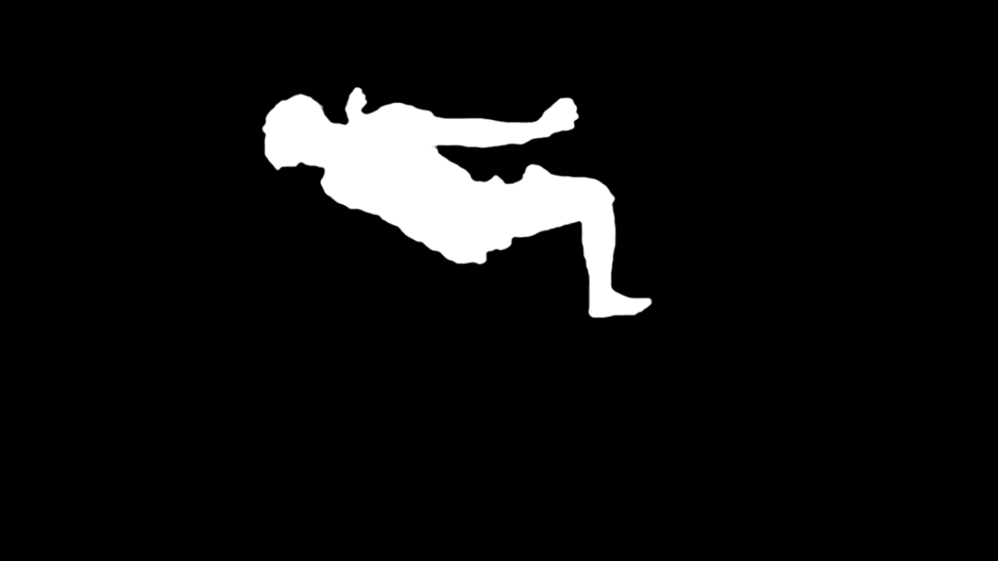
Mask Propagation（掩模传播）
mask
Notes:
The basic computational element that we focus on in this work is mask propagation.
The mask is a binary map [click], that indicates for each pixel whether it belongs to the foreground or the background. Given a correctly segmented source frame [click], the goal of mask propagation is to compute the foreground mask in other video frames.

Slide 4
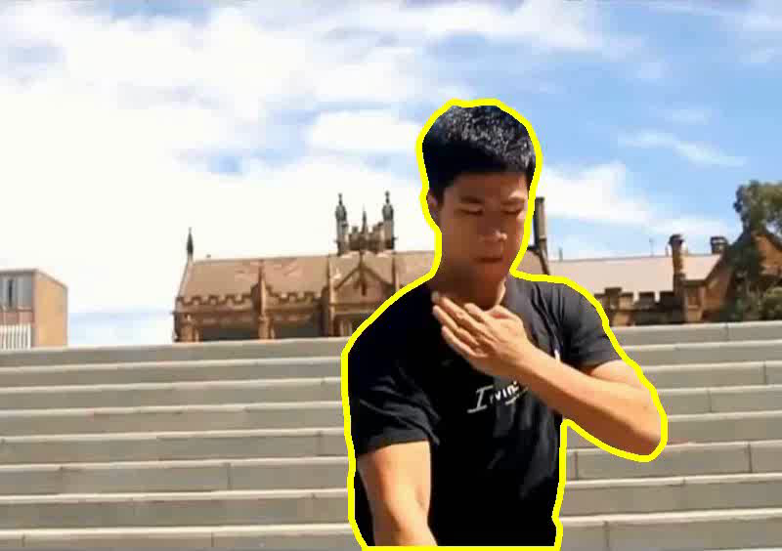
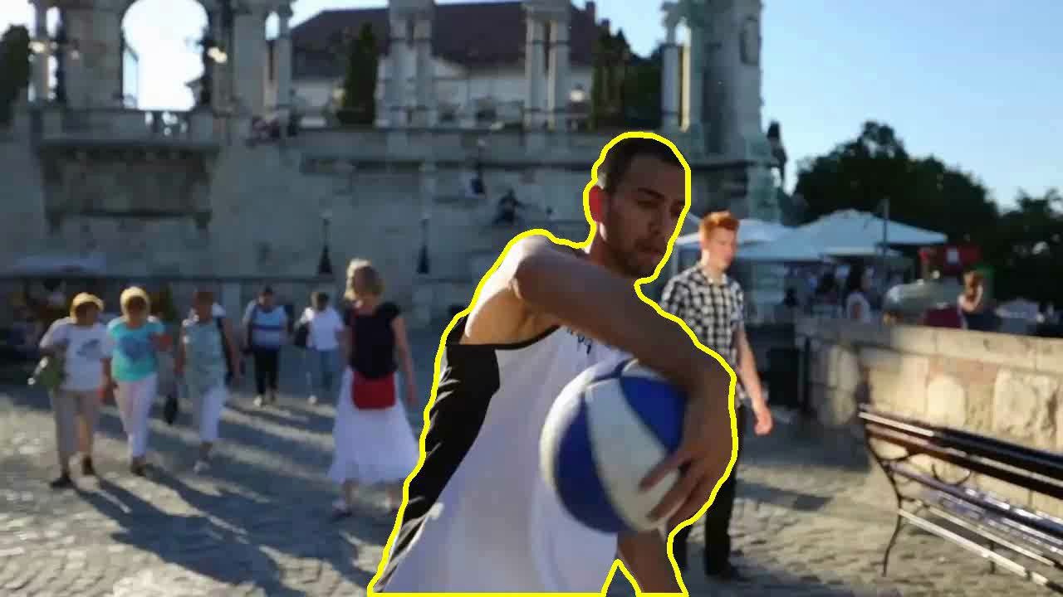
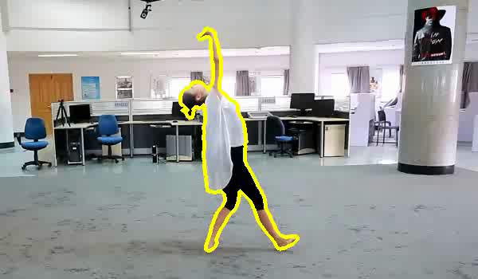
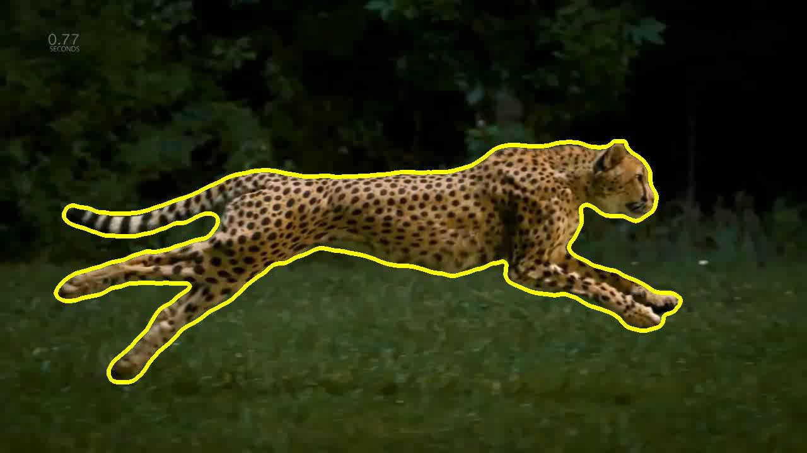
Challenges（挑战）
Fast moving objects
Topology changes
Notes:
In addition to the challenge of using a natural video background instead of a blue-screen, the main challenges for mask propagation are:
1. Fast moving and deforming foreground objects

Slide 5
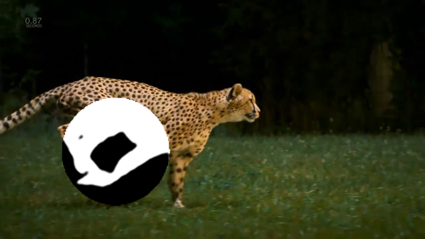
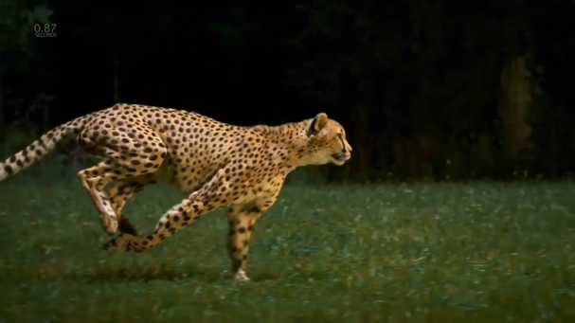
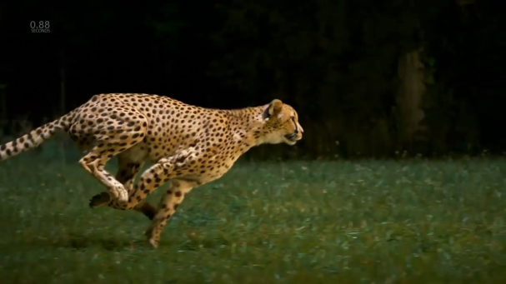

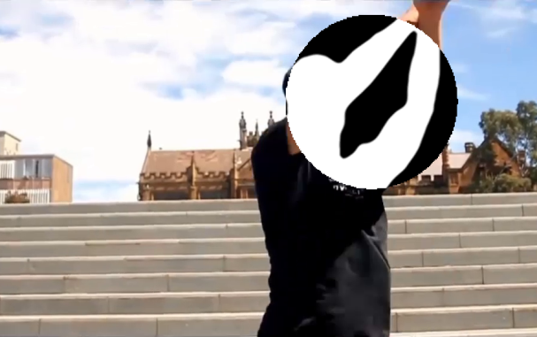
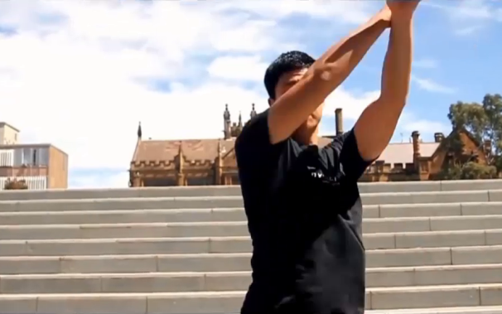
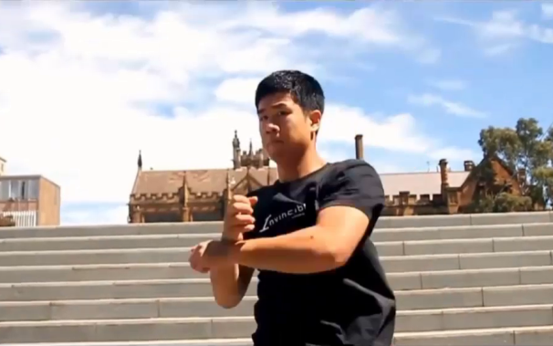
Challenges
Fast moving objects
Topology changes
F28
F32
F40
F44
Notes:
… and
2. Changes in the mask topology, [click] where holes and connected components may quickly appear and disappear.

Slide 6
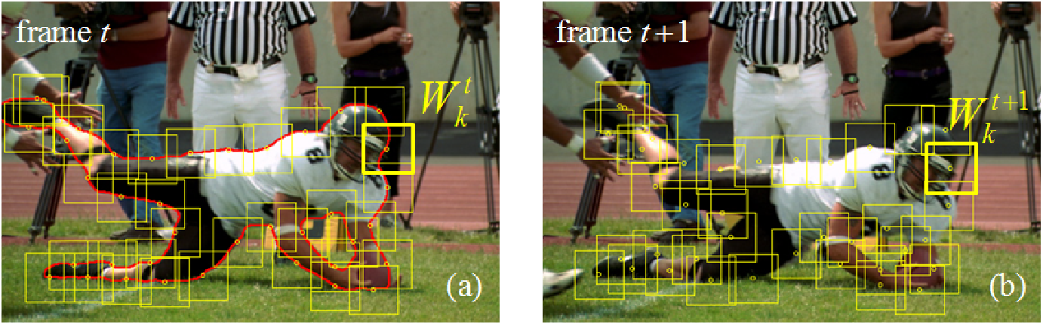
SnapCut [Bai et al. 2009]（单元切割）
Notes:
Existing state-of-the-art video cutout methods have difficulty overcoming these challenges. For example the method by Bai et al., which uses overlapping local classifiers…

Slide 7
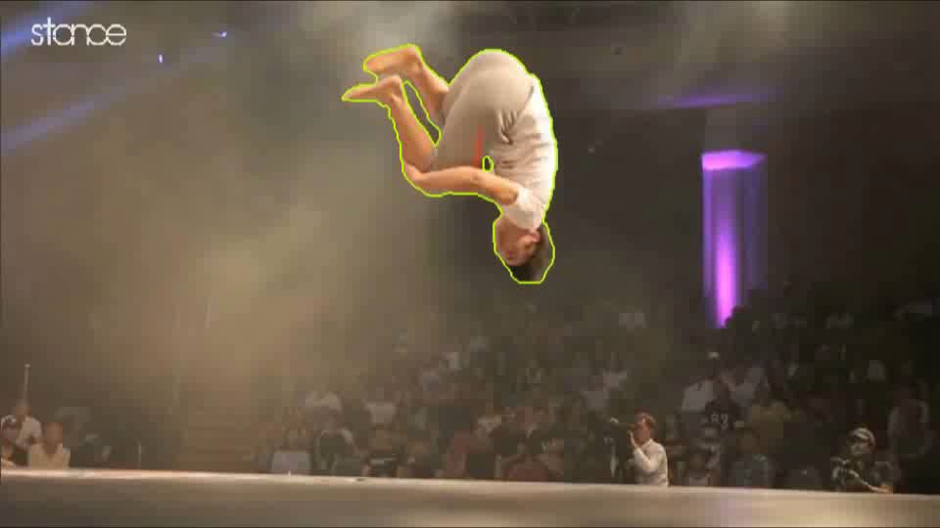
SnapCut [Bai et al. 2009]
Automatic Propagation（自动传播）
Notes:
… which cannot track fast moving objects well, as you can see in this example. Errors accumulate very quickly, and a lot of user interaction is needed to correct them.

Slide 8
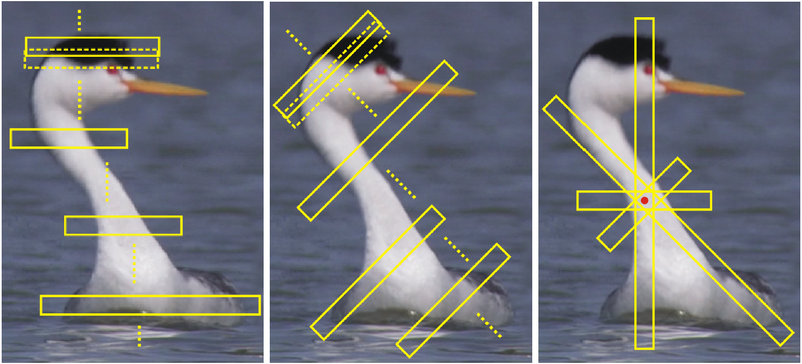
Directional classifiers [Zhong et al. 2012]（方向分类）
Notes:
A more recent method by one of our co-authors, Zhong et al, uses local classifiers in long directional windows.

Slide 9
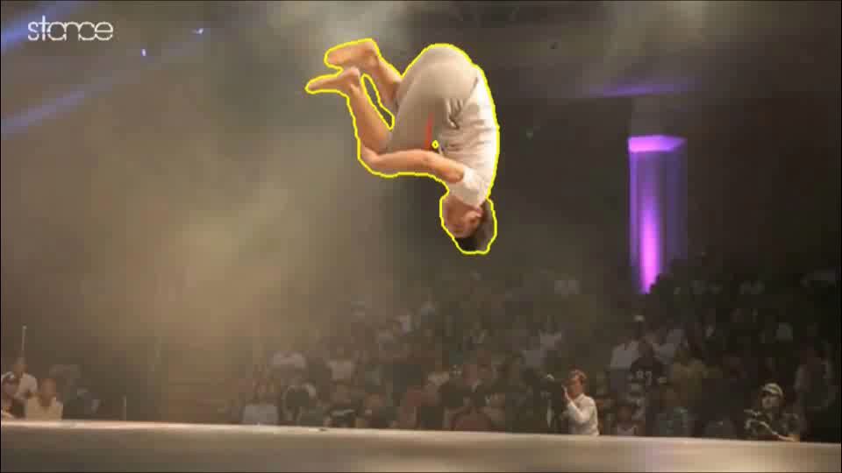
Directional classifiers [Zhong et al. 2012]
Automatic Propagation
Notes:
This produces better results, but still far from perfect on this challenging sequence.

Slide 10

Our Method
Automatic Propagation
Notes:
For comparison, here’s the result that our method is able to produce. Of course, this automatic propagation result is not perfect, and it still requires some user corrections to be made, but much fewer than previous methods.
So now let’s see how we do it.

Slide 11
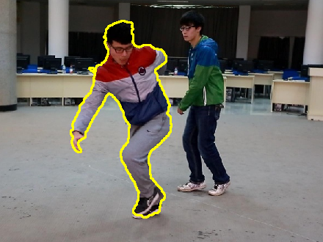
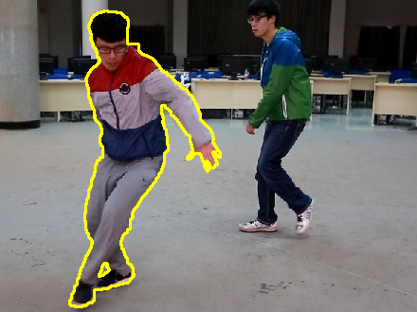
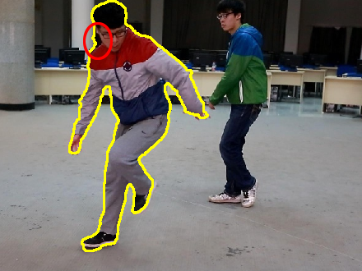
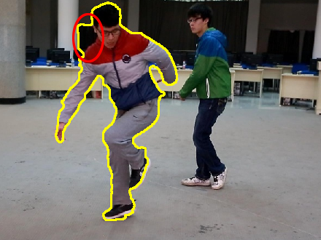
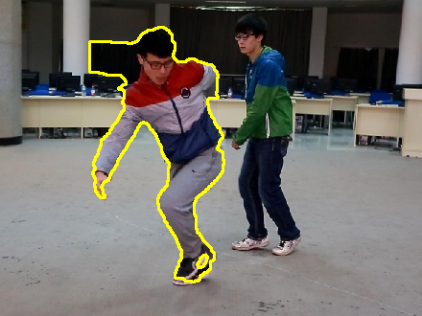
Observation（观察）
distant propagation
F80
F83
F85
F88
successive propagation accumulates error!

Slide 12
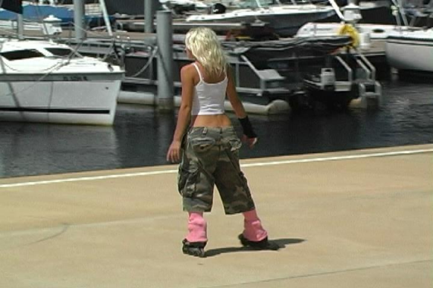
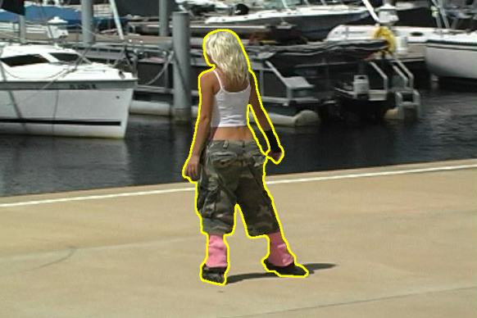
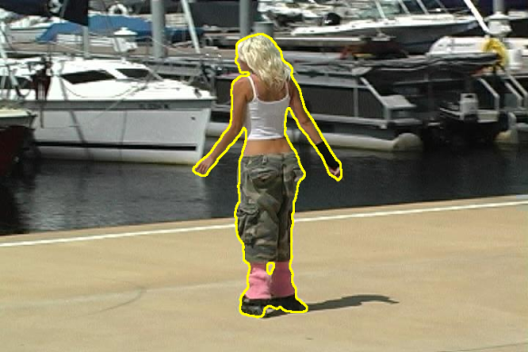
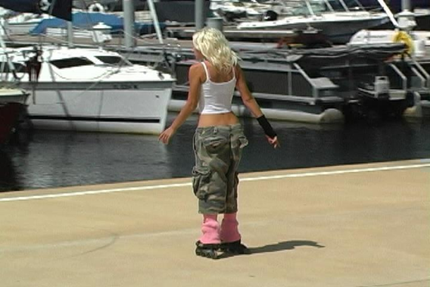
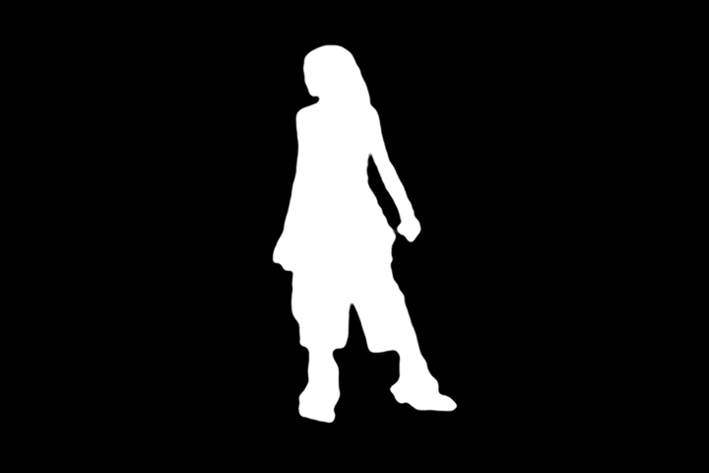
Mask Transfer（掩模迁移;）
source
target
Notes:
For mask transfer problem, we are given a pair of frames, which may or may not be consecutive, source on the left and target on the right. [click] And for the source frame we already have the correct foreground mask [click].
The goal of mask transfer is to correctly predict the foreground mask for the target frame [click].

Slide 13
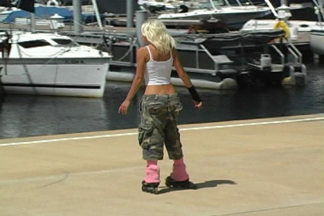
Mask Transfer（掩模迁移）
…
…
Frame t
Frame t-k
Frame t+k

Slide 14
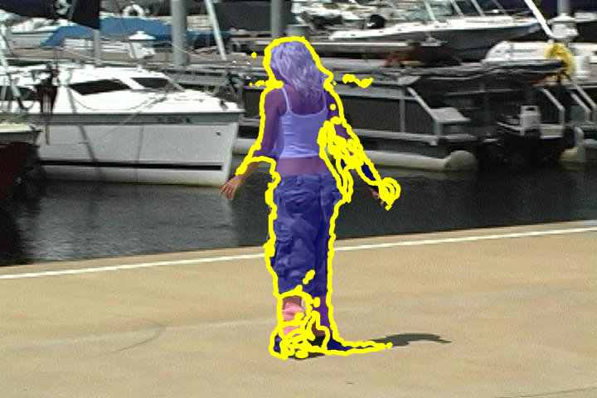
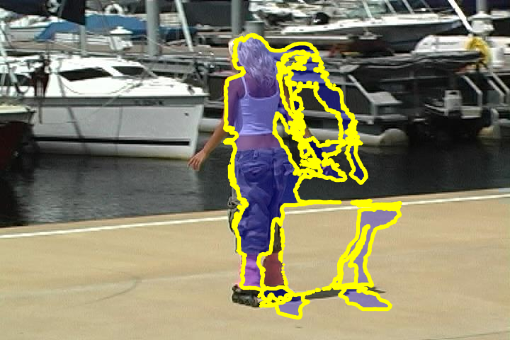
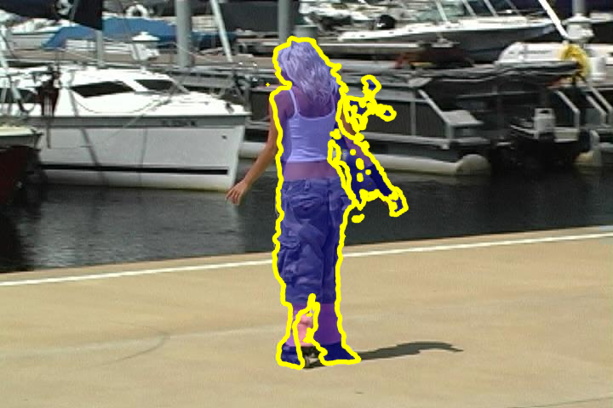
Mask Transfer with Optical Flow（光流掩模传输）
[Brox et al. 2004]
[Bao et al. 2014]
DeepFlow
source
target
Notes:
This is seemingly easy to do. All you need is to compute the optical flow from the source to the target, and use the flow to move the mask labels, right?
Well, not quite so easy. We have experimented with several state-of-the-art optical flow techniques, and their performance for this task was not satisfactory [click]. This is a result by the method of Brox et al. And here [click] is another result produced by a recent technique that is specifically targeting large displacement optical flow. As you can see it’s even worse.
[click] We also tried using a deep learning based technique, with no better results.

Slide 15
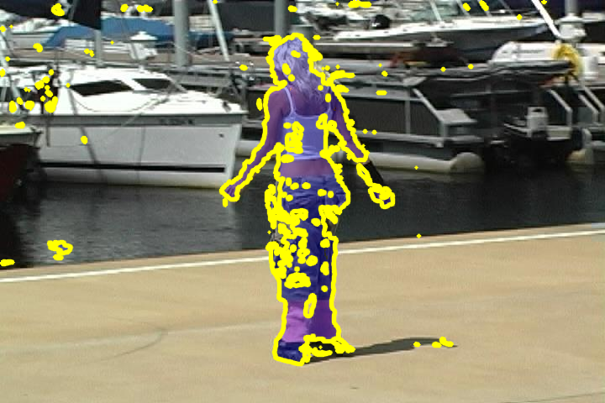
Mask Transfer with a Nearest Neighbor Field (NNF)（用最近邻场掩模传输（NNF））
PatchMatch [Barnes et al. 2009]
source
target
Notes:
The problem with optical flow is that it attempts to be too smooth. Another option is to use a less restricted Nearest Neighbor Field, NNF. The NNF is not constrained by smoothness requirements, although it does attempt to be coherent, when possible. So here’s the result of the NNF computed by the PatchMatch algorithm [click]. As you can see it’s not bad, but has many false positives, as well as false negatives.

Slide 16
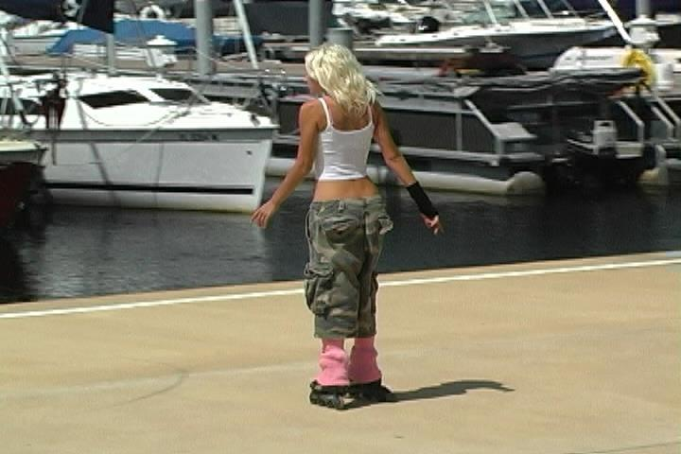
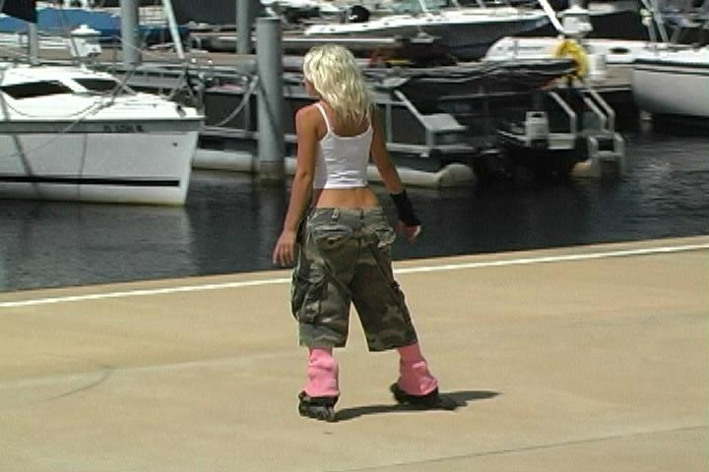
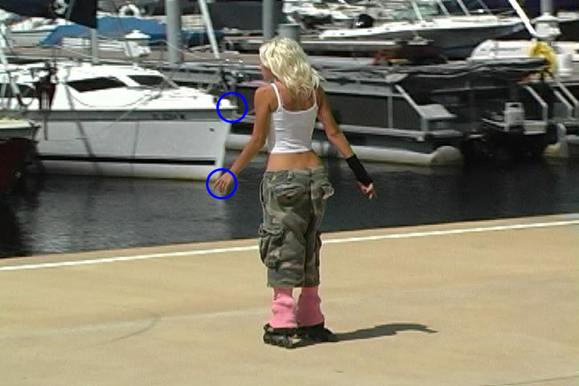

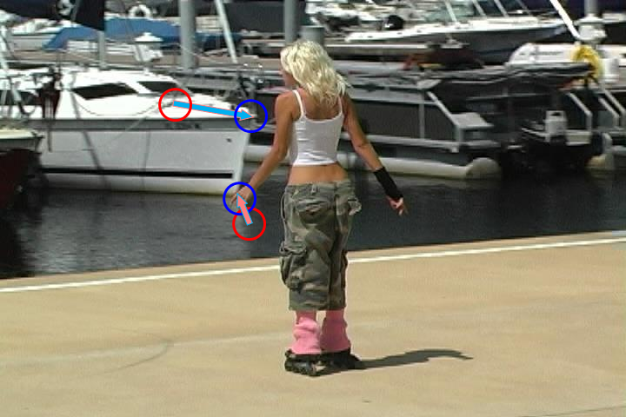
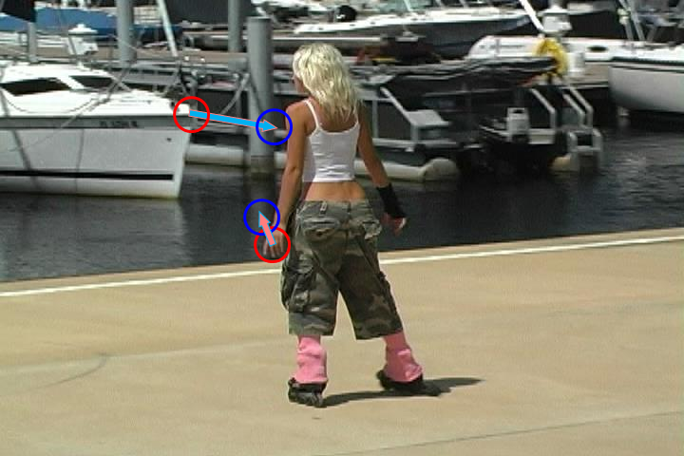
Insight（洞察）
Notes:
Our basic insight in this work, is that the displacements in the background (BG) and the foreground (FG) regions typically exhibit different and uncorrelated behavior. [click] Specifically, the BG motion is typically induced by camera motion with respect to the scene, while FG motion is independent of the camera, and often features larger displacements and non-rigid deformations.

Slide 17
Split NNF（分裂）

Slide 18
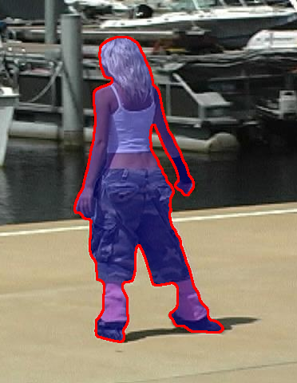



Split NNF
Source FG Image
Source FG NNF
Source BG Image
Source BG NNF
Notes:
So our approach is to compute two separate Nearest Neighbor Fields, [click] one for the FG portion and one for the BG portion, and combine their results to produce the predicted mask.

Slide 19



Split NNF - Background Alignment
source
target
Notes:
To compute each NNF, we first align the images accordingly. For example, we do some feature matching [click] in the background region, and warp the source frames [click] to make the backgrounds align before computing the NNF [click] . The exact details of how this is done may be found in the paper.

Slide 20


Split NNF - Foreground Alignment（前景对齐）
source
target
Notes:
The FG alignment is computed by template matching [click], and the source frame is also warped accordingly before computing the NNF [click].
To compute the nearest neighbor field, PatchMatch is modified to generate more coherent and local dense correspondence. There are three parts tuned in PatchMatch algorithm.

Slide 21
Nearest Neighbor Field - Initialization（最近邻域-初始化）
Random
Identity
Notes:
While initializing the correspondence of points in source image for the ones in target image, [click] we replace random mapping with identity mapping [click].

Slide 22
Nearest Neighbor Field – Random Search （最近邻域随机搜索）
Global
Local
Notes:
Instead of searching potential points in the whole image [click], we only search a local area which is centered around the current best correspondence [click].

Slide 23

Nearest Neighbor Field – Patch Distance（最近邻域-补丁距离）
$$E= \sum_{i}{ω^{d}\sqrt{{dR}_{i}^{2}+{dG}_{i}^{2}+{dB}_{i}^{2}}+}ω^{s}\sqrt{{dx}_{}^{2}+{dy}_{}^{2}}$$
Color term
Locality term
Notes:
To compute the difference value between two corresponding patches, besides the color term [click], we add a locality term [click] which could help reduce distant errors.

Slide 24

Split NNF vs. Others
Split NNF
PatchMatch [Barnes et al. 2009]
[Brox et al. 2004]
[Bao et al. 2014]
DeepFlow
VS.
Notes:
Even though this seems to be a simple change in the computation of the Nearest Neighbor Field, [click] the results seem much better than the other alternatives we compared with.

Slide 25








Bi-directional Mask Transfer (Mask Interpolation)（双向掩模传输（掩模内插））
aligned source FG (left)
aligned source FG (right)
Notes:
A similar idea is used to perform mask interpolation, where we transfer the mask which is already available from two frames to a third frame between them.
Here we compute a correspondence between the two foreground shapes [click] and use this correspondence to align each of the two source frames to the target frame.

Slide 26




Mask Interpolation（掩模内插）
aligned source FGs
aligned source BGs

Slide 27







Method Overview（方法概述）
Input
Mask Transfer
Edge Classifier
Levelset
Interaction
Notes:
So far I have mostly described the mask transfer operation [click]. However, the mask transfer result typically needs to be cleaned up a bit. This is done by applying the level set method [click].

Slide 28
Edge classification（边缘分类）
Input
Mask Transfer
Edge Classifier
Levelset
Interaction
Notes:
In addition to the predicted mask, we also provide the level set method with some classified edges.

Slide 29





Edge Classification
Notes:
[click] To predict the edges in the target image, we build a KNN classifier based on the edge information collected from the source image.

Slide 30





Edge Classification
$$θ$$
$$(r,g,b,$$
$x,y$,
$$sinθ,cosθ)$$
Notes:
In detail, [click] for each edge point in the source image, we associate two pixels, [click] which are on the two sides of the edge point [click] . For each such pixel which belongs to either foreground [click] or background[click].
We extract a 7 dimensional feature vector, consisting the information of colors [click], spatial coordinates [click], and gradient orientation [click] . Once all such pixels in the target image are classified, the edge point can be classified from the two side pixels.

Slide 31



Edge Classification
Notes:
We classify each edge in the target frame as either background [click], foreground [click], or silhouette edge [click]. The results are not reliable enough to give us the full outline of the foreground region, but the detected silhouette edges help the level set method to converge to the correct foreground boundary.

Slide 32
Levelset（水平集）
Input
Mask transfer
Edge classifier
Levelset
Interaction

Slide 33

Levelset without Silhouette Edges（无轮廓边集）
Notes:
Here we show the process that segmented mask is smoothed by levelset without silhouette edges.

Slide 34

Levelset with Silhouette Edges
Notes:
This is processed with silhouette edges.

Slide 35

Automatic mask transfer comparison（Automatic mask transfer comparison）
Rotobrush
Zhong et al. 2012
SeamSEG
Ours
Notes:
We compiled a set of 22 video clips, each with a ground truth foreground segmentation, and compared the accuracy of our method’s automatic mask transfer with a number of previous methods.

Slide 36




















Automatic mask transfer comparison
Rotobrush
Zhong et al. 2012
SeamSEG
Ours
Notes:
The full results are in the paper, but in a nutshell, the accuracy of our method is better, especially when transferring the mask to a distant frame, and when the video in question contains fast foreground motion and/or strong foreground deformations.
[click] This is a column of result zoomed in.

Slide 37
Interaction（相互作用）
Input
Mask transfer
Edge classifier
Levelset
Interaction
Notes:
No matter how much we tune and improve the mask transfer, there are always the possibility of errors. So, in practice the system relies on the user to interactively fix any mask transfer errors. So the fact is that with our more accurate mask transfer, the amount of required user interaction is smaller than other methods. Let me show you that this is indeed the case.

Slide 38
















Automatic mask transfer comparison
Rotobrush
Zhong et al. 2012
SeamSEG
Ours

Slide 39
















Automatic mask transfer comparison
Rotobrush
Zhong et al. 2012
SeamSEG
Ours

Slide 40

Real-time Interactive Session with JumpCut（实时交互式会话与跳转）

Slide 41





Observation
distant propagation
F80
F83
F85
F88
Successive propagation accumulates error!
Notes:
One observation that we make is that propagating the mask from one frame to the next, [click] actually this might not be the best thing to do. Although successive frames are similar to each other, still the propagation is imperfect, and small errors are introduced, and then accumulate to a large error.
With a properly designed mask transfer algorithm, we can achieve a better result by transferring directly to a distant frame. [click]

Slide 42









Distant Transfer & Interpolation Workflow （远程传输与插值工作流）
Notes:
So our video cutout workflow proceeds by jumping ahead [click], using distant transfer, and then [click] propagating the masks to the intermediate frames using mask interpolation.

Slide 43

Real-time Interactive Session with JumpCut (sped up 1.5x)（实时交互式会话跳切（加快1.5倍））
Notes:
Here we show a real-time interactive session using our JumpCut method. The frame line in the bottom shows the source and target frames in the mean time.
…
As you can see, many frames don’t need any touchup.

Slide 44
Thank you!

